Slide 1
STUDENT RECORD MANAGEMENT SYSTEM

Slide 2
INTRODUCTION
A “STUDENT RECORD” is set of records related to student. This project was developed using Java language ,Netbeans IDE and database used for the project is MongoDB.
It will generate a report in the system which will help the user to check the status of the student’s, fees status, exam record and attendance status..
It used databases concept to store all the information which is related to the student
This system focuses on updating the data. Reports produced in the system make easier to check the status of the student.
Besides this system is a further development of conventional method using forms which were used before.

Slide 3
MODULES OF PROJECT
Start Page
Login Module
Home Page
Student Record Module:->
Enter a Record
Update a Record
Search a Record
Attendance Module:->
Add Attendance
View Attendance

Slide 4
MODULES OF PROJECT(Contd.)
Fees Detail Module
Insert Fees Details
Update Fees Details
Search Fees Details
Exam Record Module:->
Enter a Exam Record
View a Exam Record

Slide 5
DEVELOPMENT TOOLS
TOOLS USED
Platform | Windows
Operating System | Windows 8/8.1
Front End Tool | Core JAVA(Netbeans)
Back End Tool | MongoDB

Slide 6
DEVELOPMENT TOOLS(CONTD.)
Netbeans is a software development platform written in Java. The Netbeans Platform allows applications to be developed from a set of modular software components called modules. Application based on the Netbeans Platform, including the Netbeans integrated development environment(IDE),can be extended by third party developers.
MongoDB is a cross-platform document oriented. Classified as a NoSQL database, MongoDB eschews the traditional table-based relational database structure, making the integration of data in certain types of applications easier and faster

Slide 7
MAPPING OF MODULES
START FRAME
LOGIN FRAME
RECORD FRAME
ATTENDANCE
FRAME
FEES DETAIL
FRAME
EXAM RECORD FRAME
SUBMIT,
SERACH & UPDATE
CREATE,
SEARCH & UPDATE
ADD
ATTEN DANCE
ENTER RECORD
VIEW
ATTENDANCE
VIEW RECORD

Slide 8
START PAGE MODULE
At Run Time,
if
the admin press ENTER BUTTON then he/she is moved to the LOGIN module
else(the EXIT BUTTON)
the admin exits from the Project Window

Slide 9
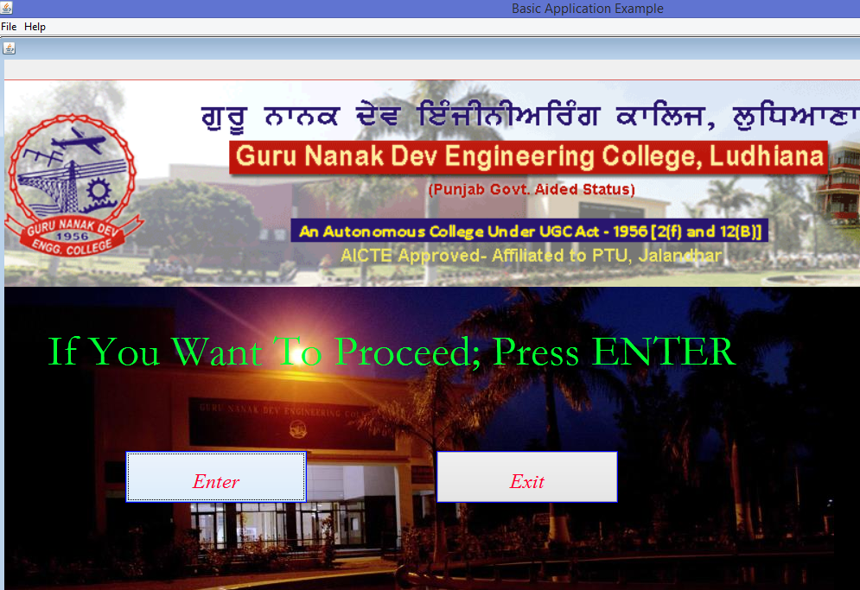

Slide 10
LOGIN MODULE
Login form is the first form of the project.
This form is added to restrict unauthorized users from accessing the sensitive data.
Only authorized users will be able to access the application.

Slide 11
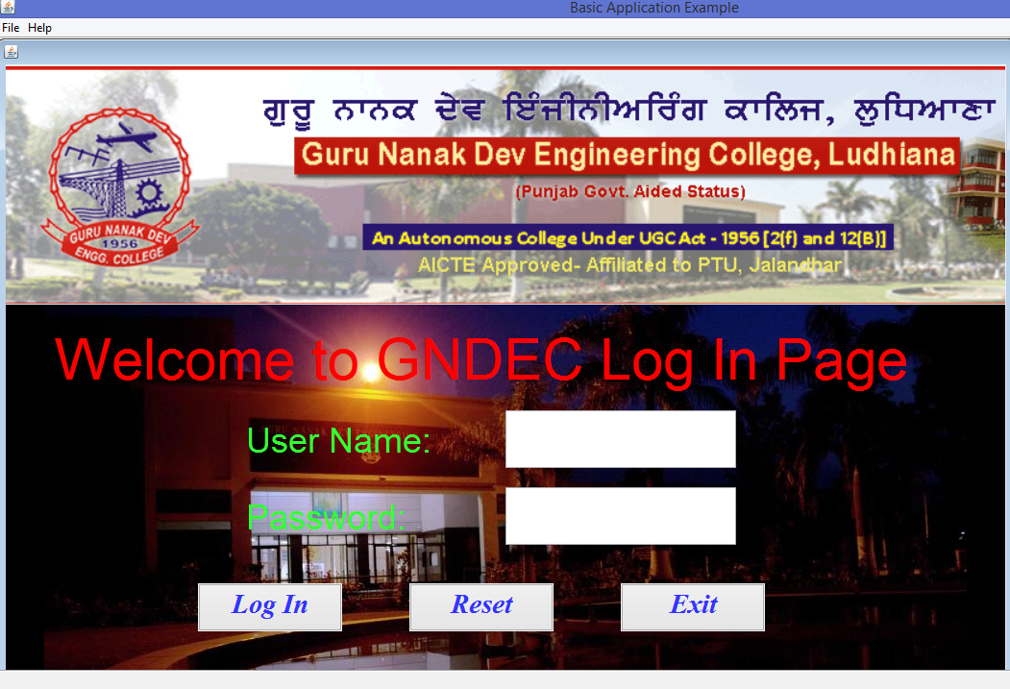

Slide 12
HOMEPAGE
This form opens when the user’s authentication is successfully completed.
This form provides the user to access all the other modules.
This form is the main form. When we press the home button from any other module, we again enter in this form.

Slide 13
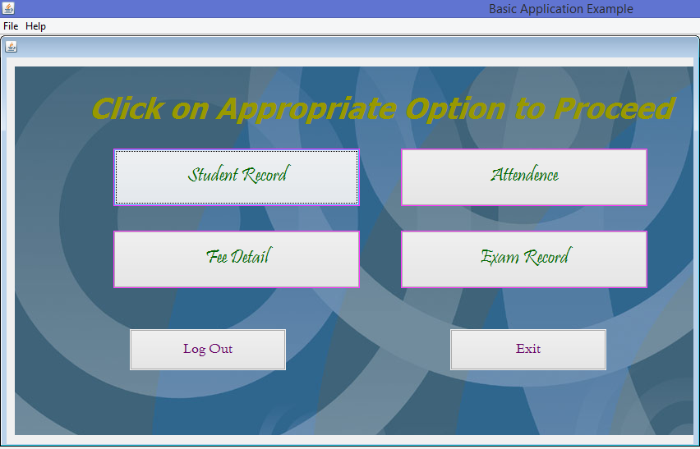

Slide 14
STUDENT RECORD MODULE
In this module user can insert the information of student(s).
Whenever user wants to view the information of a student then he/she has to enter the student’s id and then presses the search button.
Whenever user wants to update the information of a student then he/she has to
(I) Enter the student’s id.
(II) Press the search button.
(III) Apply changes to the required filled, then click on update button.

Slide 15
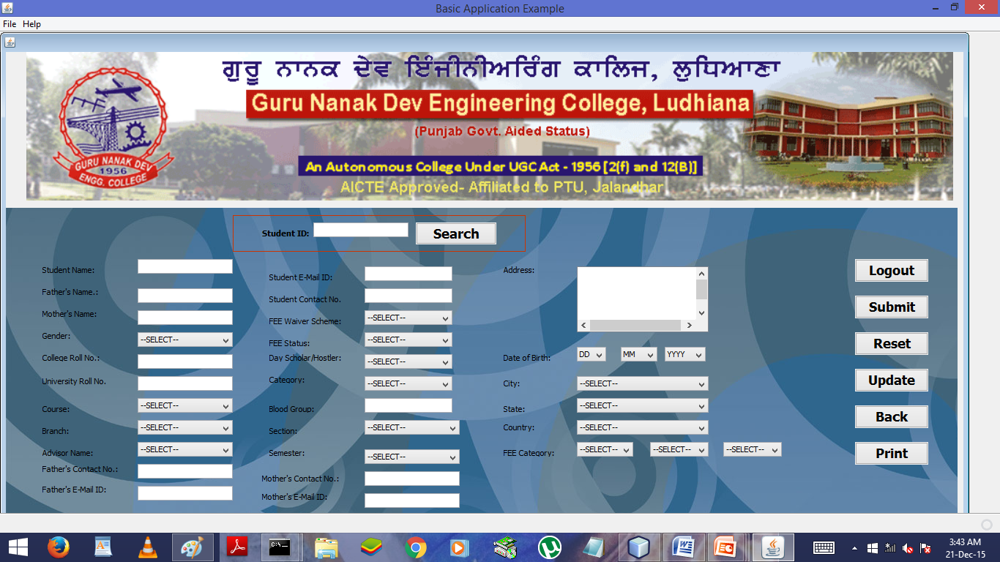

Slide 16
ATTENDANCE HOME PAGE MODULE
This module helps to enter the record of attendance of a student and view the set records
A new record can be created by clicking on ADD ATTENDANCE button on the ATTENDANCE HOME PAGE.
User can apply changes to the recent information if required.
User can view records from set of records by entering Student ID, Course, Semester, Branch.

Slide 17
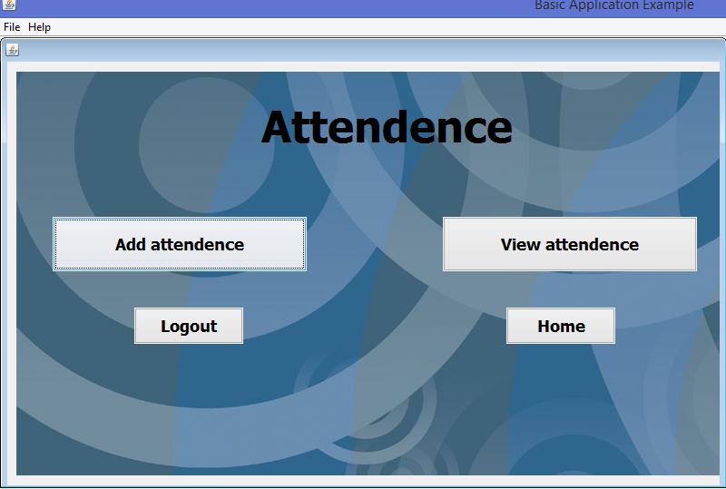

Slide 18
ADD ATTENDANCE MODULE
In this module ,authorized users can insert the attendance record of a student
Authorized user can apply changes to the previous created record
Authorized users can apply changes to the recent records relating to attendance if required.
If the printer is attached to the system then the hard copy can be taken/carried out.

Slide 19
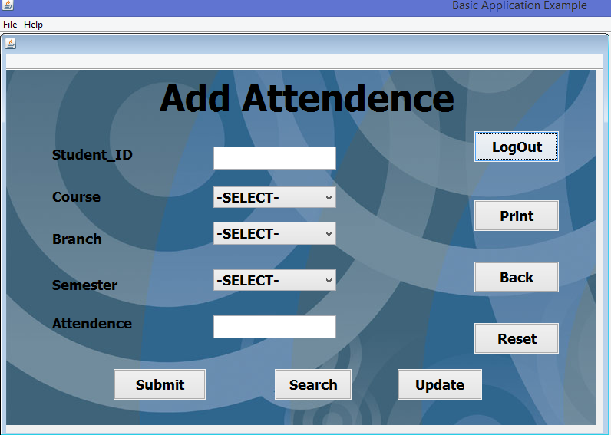

Slide 20
VIEW ATTENDANCE MODULE
In this module ,authorized users can view the attendance records
For viewing information user has to enter the Student ID, Course, Branch and Semester and then press on SEARCH button
If the system is attached to the printer then hard copy of the record scan be taken

Slide 21
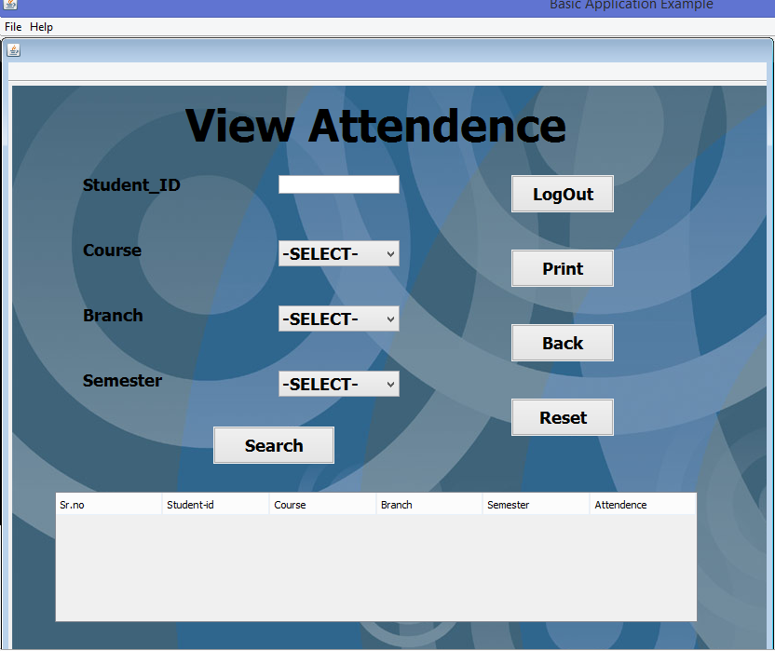

Slide 22
FEES DETAIL MODULE
In this module, authorized users can enter the fees details of a student.
Search operation can also be performed in this module.
User can update the required information of a student whenever required.

Slide 23
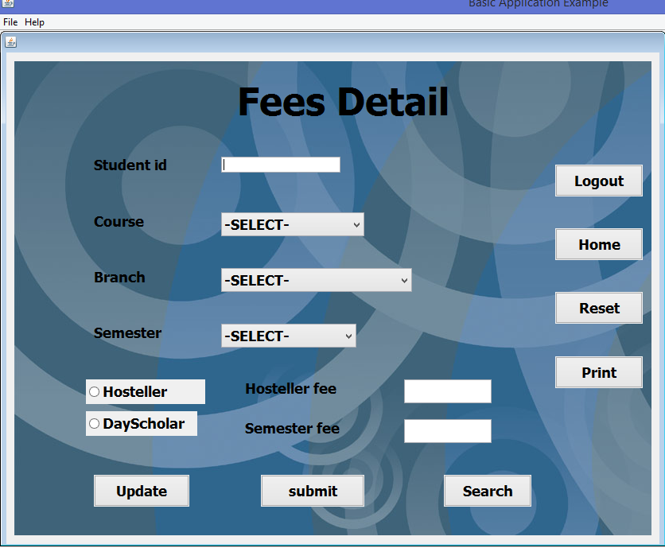

Slide 24
EXAM RECORDS HOME PAGE
In this section, user can enter or view the marks of a student.
By clicking/pressing on button user can perform the operation related to the exam record.
In this module, marks of students are evaluated by specifying data.

Slide 25
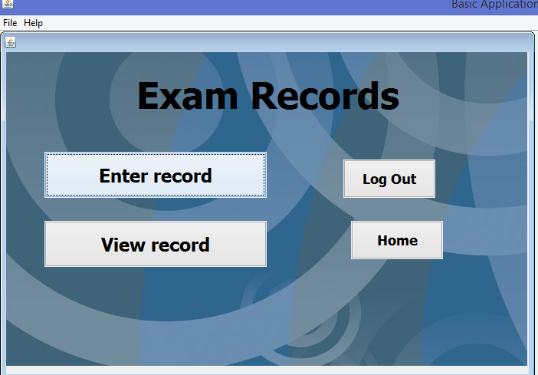

Slide 26
ENTER RECORD MODULE/ ENTER EXAM DETAILS
In this module, the information related to the students marks is entered and evaluated.
This module is also used to display the record of a student .
This module is also used to update the required information later if required

Slide 27
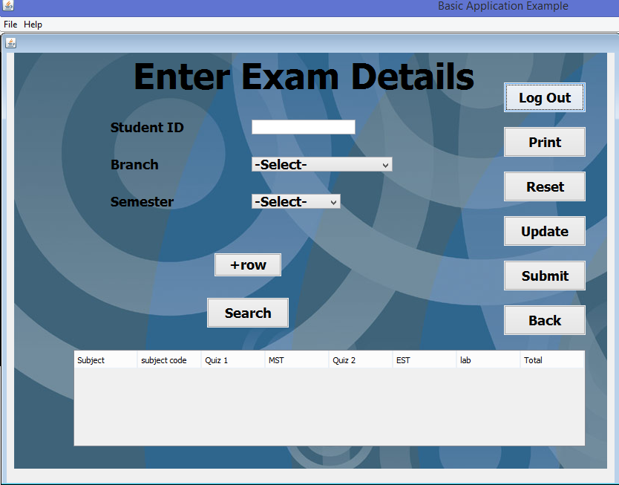

Slide 28
VIEW RECORD MODULE
In this module, the marks record of a student can be viewed by specifying student id and semester.
Hard copy can be taken if printer is attached to the system.
This module is visible to the authorized users only.

Slide 29
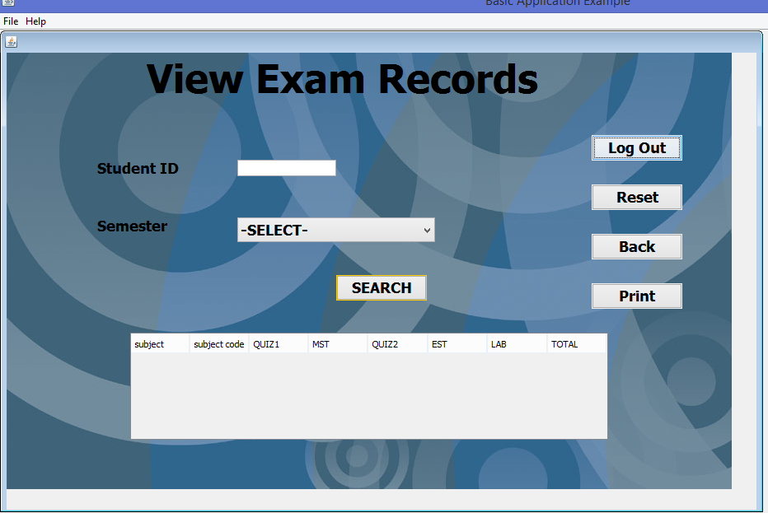

Slide 30
SUBMITTED TO:-> PROF. SUKHJIT SINGH SEHRA
SUBMITTED BY:->
MANJINDER SINGH
1311091
D3CSE(E2)

Slide 31
THANKS…

